Slide 1

Machine Learning Project : Heart Disease Prediction
Stelios Katsoulakis

Slide 2
Contents
Problem Statement - Project Details
Methodology
Lessons Learned

Slide 3
Contents
Problem Statement - Project Details
Methodology
Lessons Learned

Slide 4
Problem Statement - Project Details
Machine learning Classification Project using Python
Uses data to teach a computer to make predictions
Predicts heart disease in the specific dataset
Helps doctors

Slide 5
Contents
Problem Statement - Project Details
Methodology
Lessons Learned

Slide 6
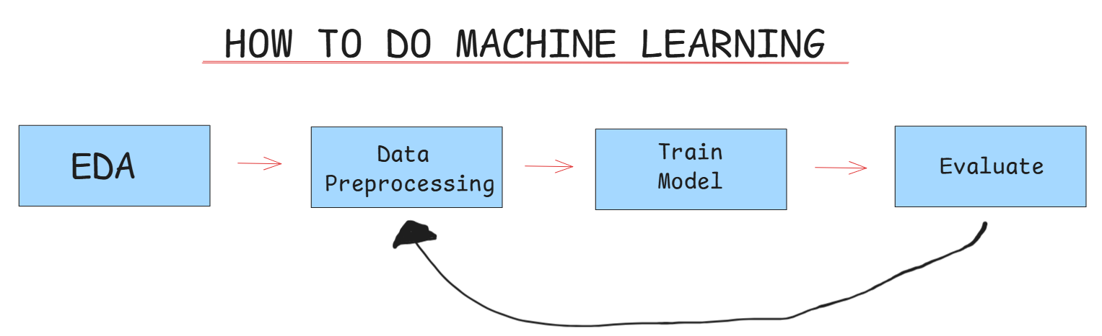
Methodology
4 step process:
  Exploratory Data Analysis (EDA)
  Data Cleaning & Preprocessing
  Model Training & Selection
  Evaluation & Results

Slide 7

Exploratory Data Analysis (EDA)
Gaining a clear picture of the data
Notice patterns:
  Distributions
  Outliers
  Correlations

Slide 8
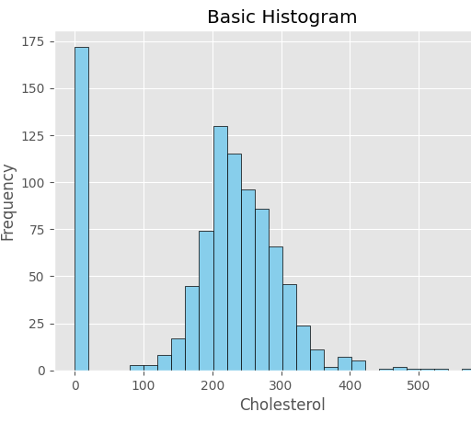
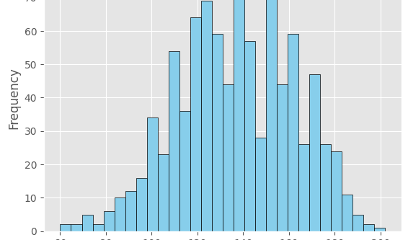
Exploratory Data Analysis (EDA)
Distribution of features

Slide 9
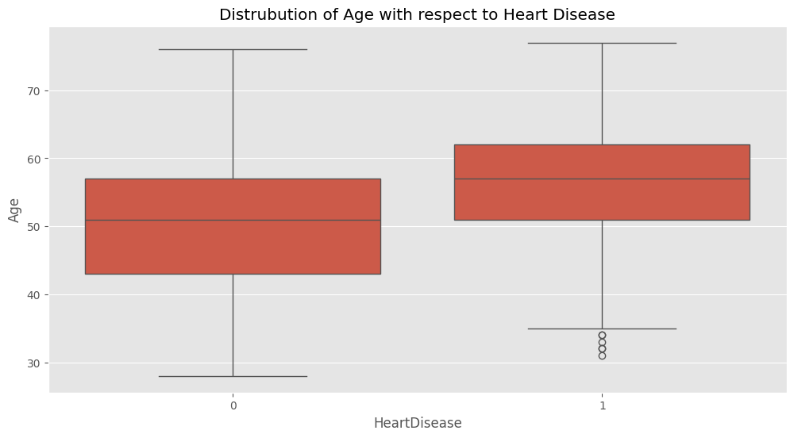
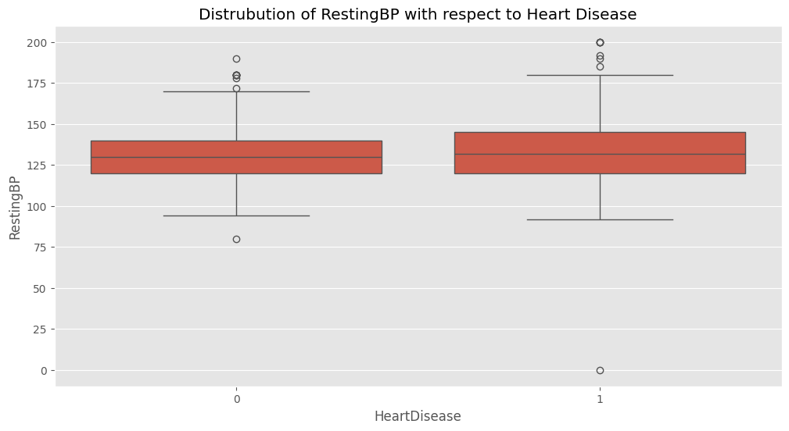
Exploratory Data Analysis (EDA)
Found the outliers using box plots
Dots are outliers

Slide 10
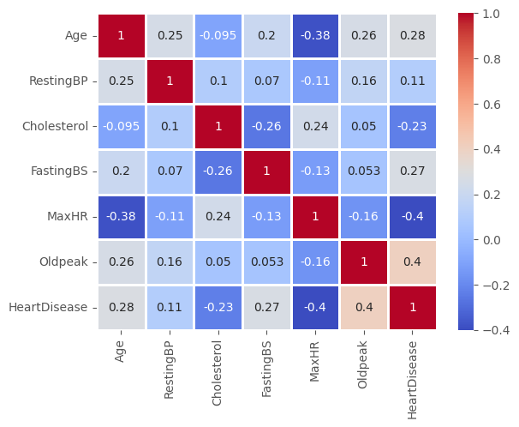
Exploratory Data Analysis (EDA)
Used a Heatmap to find the correlation between features
More Red: Higer Correlation
More Blue: Lower Correlation

Slide 11

Data Cleaning & Preprocessing
The computer cannot understand the data
Data should be changed and "organized"
Removed or fixed missing data
Converted text data into numbers

Slide 12

Model Training & Selection
The way the computer makes the predictions
Training of the computer using examples

Slide 13
Model Training & Selection
Non Decision Tree Based Models
Decision Tree Based Models
K-Nearest Neighbors (KNN)
Support Vector Machine (SVM)
Naïve Bayes
Logistic Regression
Split in Training and Testing Datasets
Decision Trees
Random Forests
Split in Training and Testing Datasets

Slide 14
Evaluation & Results
5-Fold Cross-Validation Results (F1 Score)
Model | Fold 1 | Fold 2 | Fold 3 | Fold 4 | Fold 5 | Mean F1 | ± Std Dev
Logistic Regression | 0.899 | 0.888 | 0.864 | 0.852 | 0.824 | 0.865 | 0.054
SVM | 0.907 | 0.892 | 0.904 | 0.873 | 0.842 | 0.883 | 0.048
Random Forest | 0.916 | 0.892 | 0.877 | 0.863 | 0.857 | 0.881 | 0.042
Training the computer to make predictions in the best way
Using Cross Validation
Accuracy is not enough
Used another metric (F1 Score)
Shows how many True Positives and True Negative the model had

Slide 15
Contents
Problem Statement - Project Details
Methodology
Lessons Learned

Slide 16
Lessons Learned
Positives
How can I improve?
Finished my first Machine Learning Project
With a little patience everything can be done
Model accuracy is not enough
Limitations of data can affect results

